Slide 1




Uncovering Discrimination Clusters: Quantifying and Explaining Systematic Fairness Violations
Ranit Debnath Akash¹, Ashish Kumar², Verya Monjezi¹,
Ashutosh Trivedi³, Gang (Gary) Tan², Saeid Tizpaz-Niari¹
¹University of Illinois Chicago
²Pennsylvania State University
³University of Colorado Boulder

Slide 2

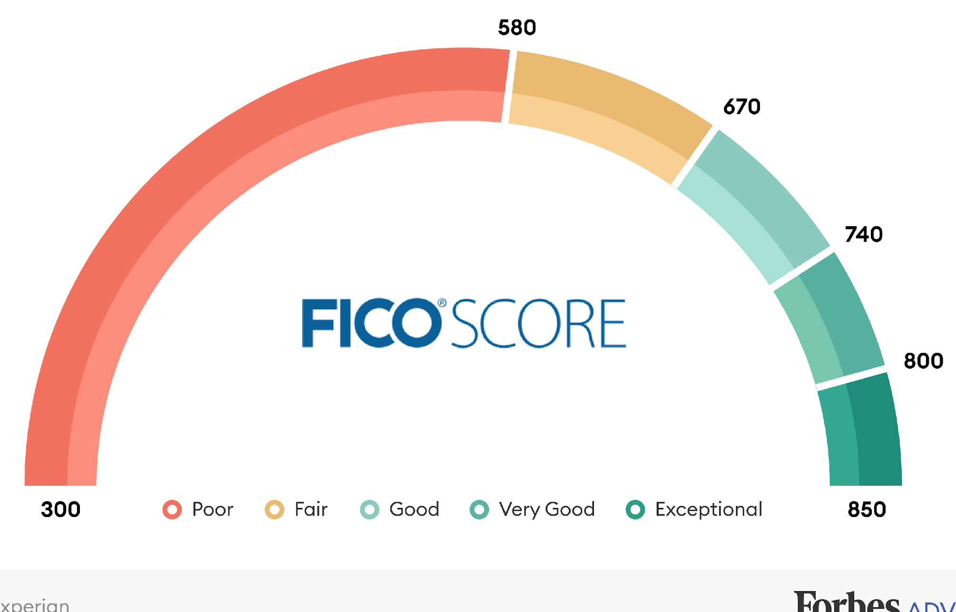
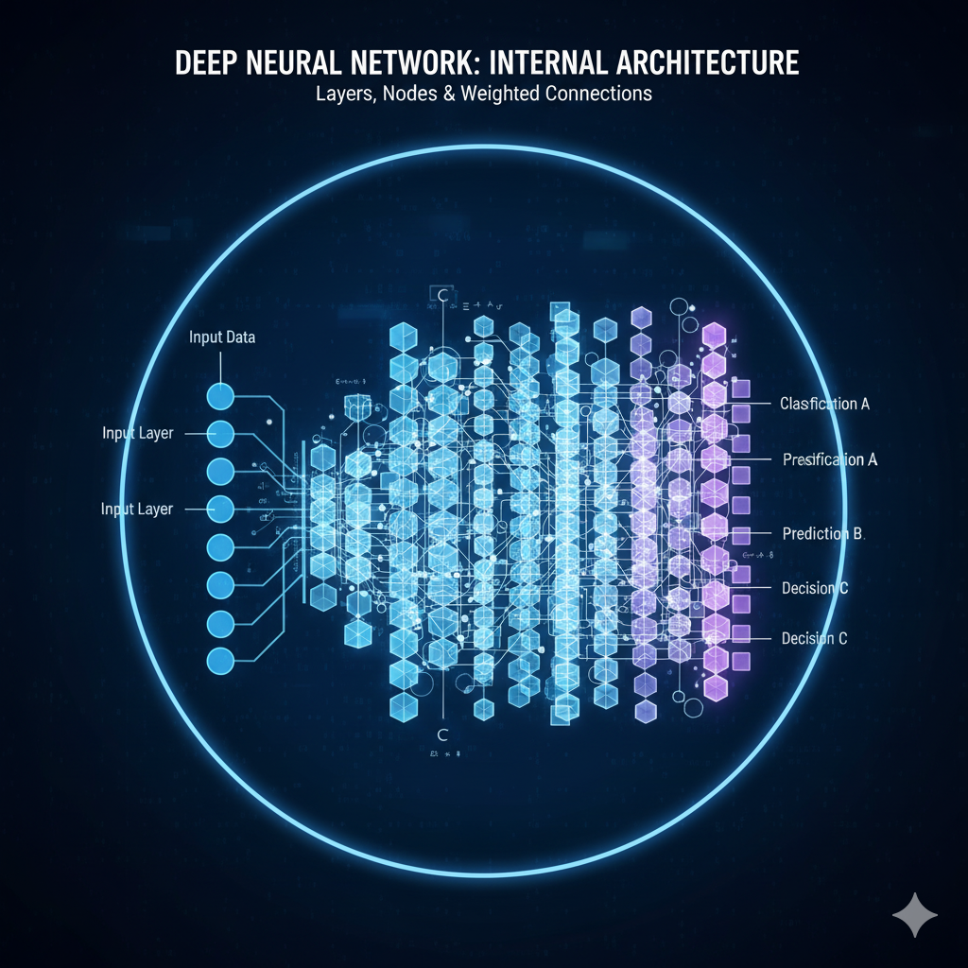
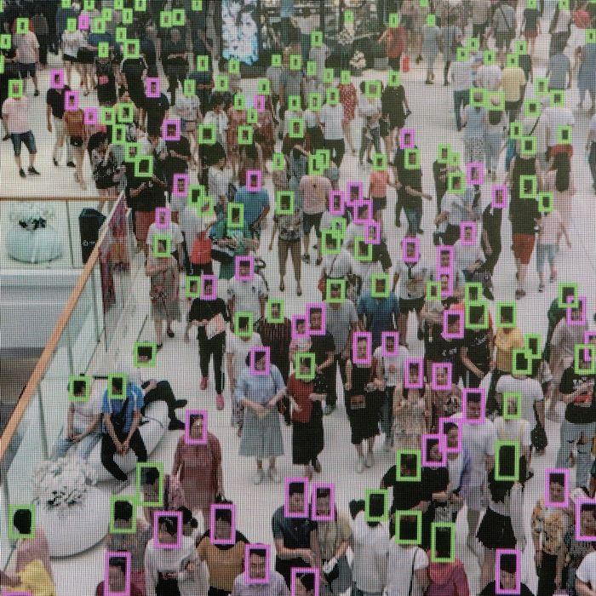

AI-Driven Software Solutions
Criminal Justice
Risk Assessment
Facial Analysis
Hiring Decision

Slide 3
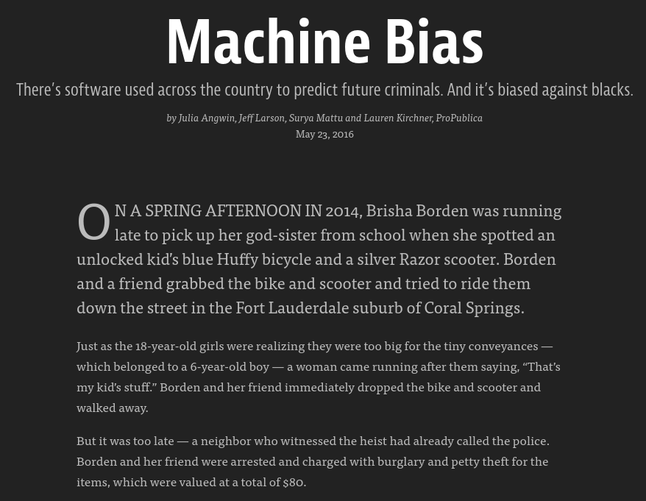
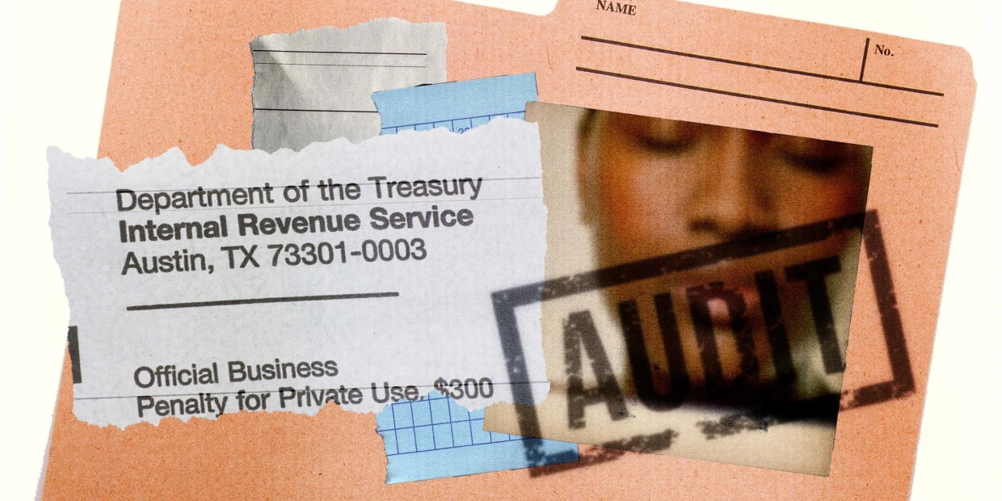
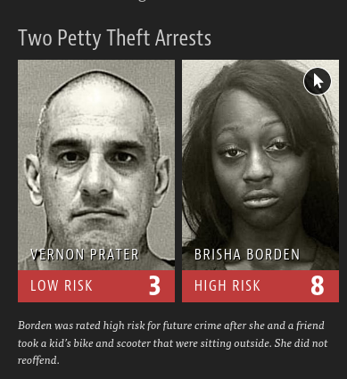
ML Software Discrimination
https://siepr.stanford.edu/news/irs-disproportionately-audits-black-taxpayers
https://www.propublica.org/article/machine-bias-risk-assessments-in-criminal-sentencing

Slide 4
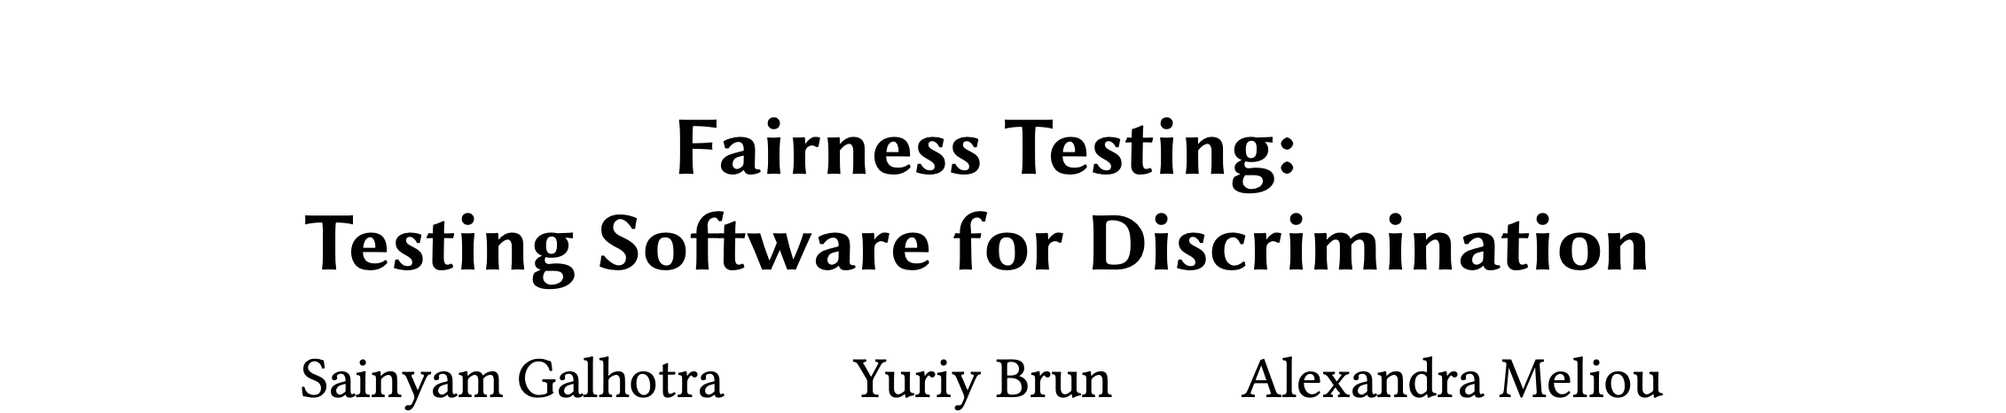
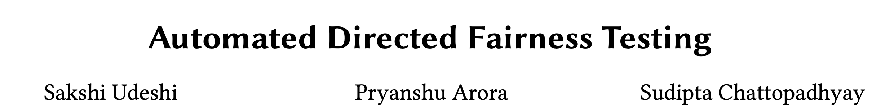
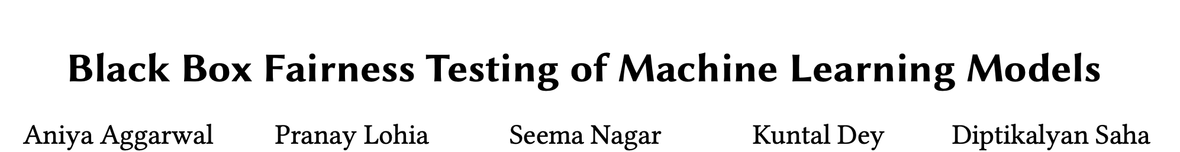
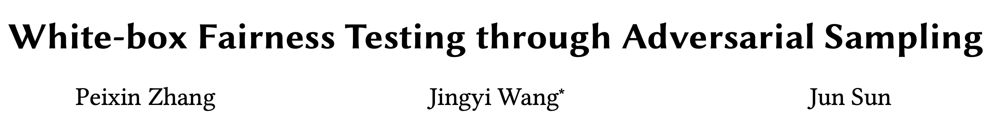

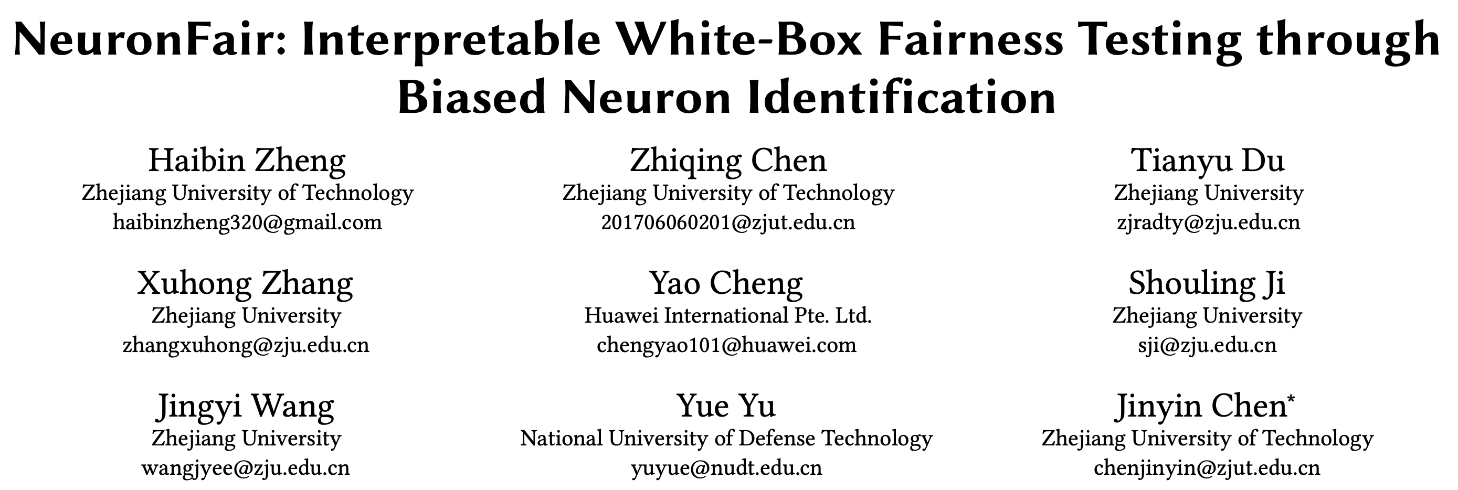
Verifying/Testing against Discrimination
Themis
FSE’17
AEQUITAS
ASE’18
Black-box
FSE’19
ADT
ICSE’20
EIDIG
ISSTA’21
ICSE’22

Slide 5



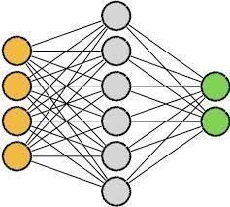


Fairness Metric: Individual Discrimination (2-discriminant)
Counterfactual

Slide 6
Why Individual Fairness is not enough?
Fairness is not binary!
No prioritization based on severity!
No systemic bias identification!

Slide 7



Proposed Notion of Fairness: k-discriminant
K : # partitions
Individual
0.91
Counterfactual
0.37
P₃
CF ₁
Ꜫ
P₂
0.76
P₁
CF ₂
P_{k}
0.03
CF ₁₅

Slide 8
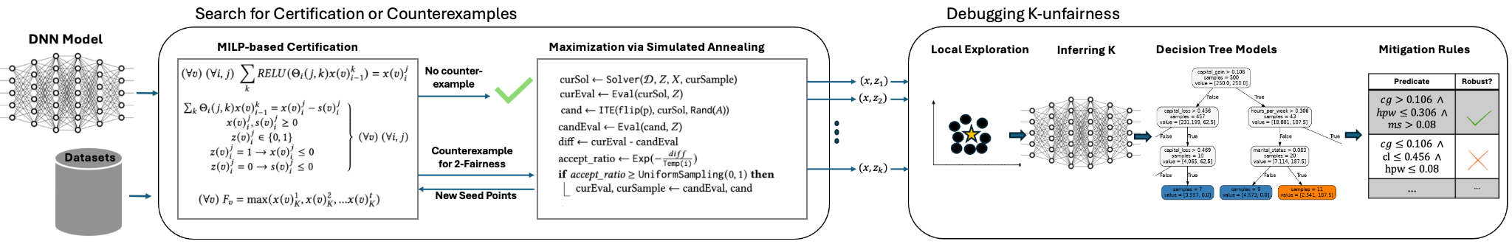
Approach (HyFair)

Slide 9
Evaluation
RQ1 How does HyFair compared to FairiFY in certifying 2-fairness and finding counterexamples?
RQ2 What is the performance of different randomized search algorithms in characterizing k-discrimination?
RQ3 What are the performance and complexity of HyFair explanations as compared to the baseline LIME?
RQ4 How does HyFair help improve fairness?
Benchmarks:
Adult Census: 15 DNNs
Bank Dataset: 8 DNNs
State-of-the-art:
FairiFy (ICSE’23)
LIME (KDD’16)
[1] S. Biswas et al, “Fairify: Fairness Verification of Neural Networks” in Proceedings of the 45th International Conference on Software Engineering, ICSE ’23 [2] M. T. Ribeiro, et al “”why should i trust you?” explaining the predictions of any classifier,” in Proceedings of the 22nd ACM SIGKDD (2016)

Slide 10
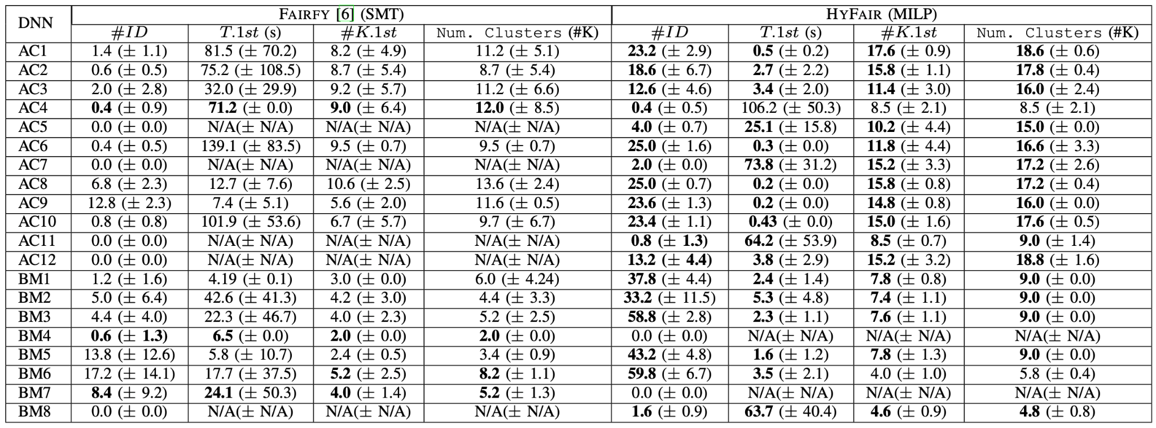
SMT (Fairify) vs. MILP (HyFair) solvers for detecting and quantifying unfairness of DNNs (RQ1).

Slide 11
SMT (Fairify) vs. MILP (HyFair) solvers for detecting and quantifying unfairness of DNNs (RQ1).
Answer RQ1:
Our MILP formulation outperforms the baseline Fairify in more than 80% of the time.
MILP formulation also finds instances that manifest larger k-discrimination violation.

Slide 12
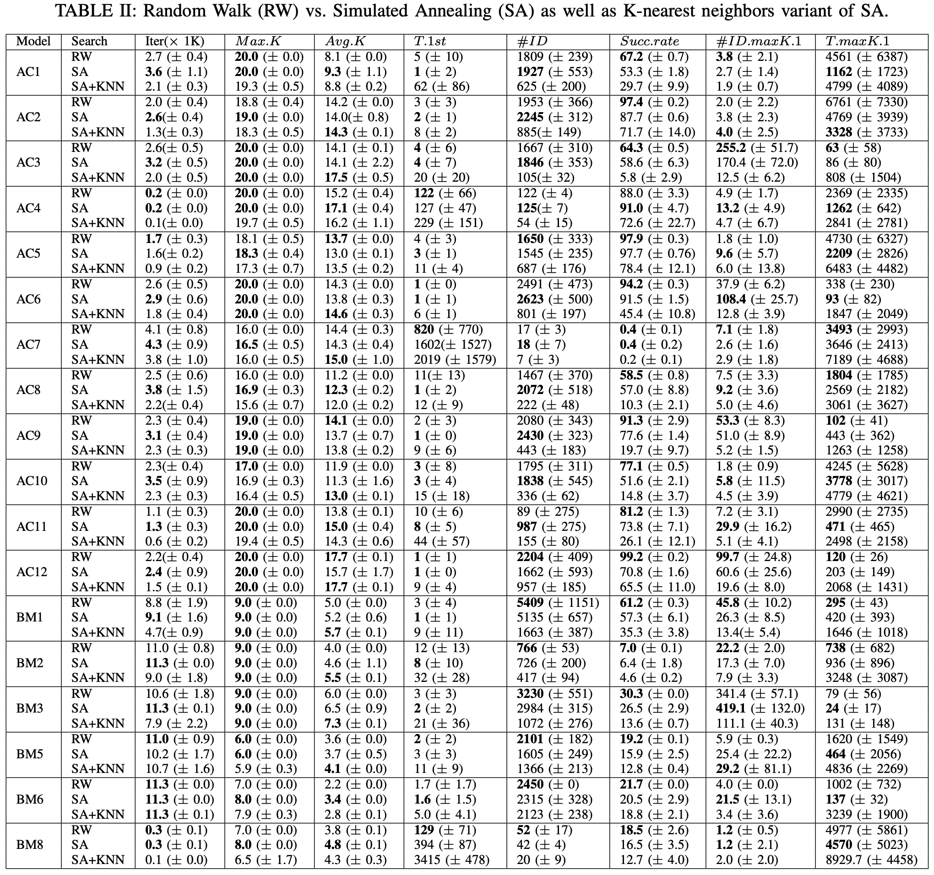
RQ2: Search for k-discrimination.

Slide 13
RQ2: Search for k-discrimination.
Answer RQ2:
The simulated annealing (SA) outperforms other randomized search strategies in finding maximum k-discrimination, the time to the first instance of max k, and the number of unique instances with max k-discrimination.

Slide 14
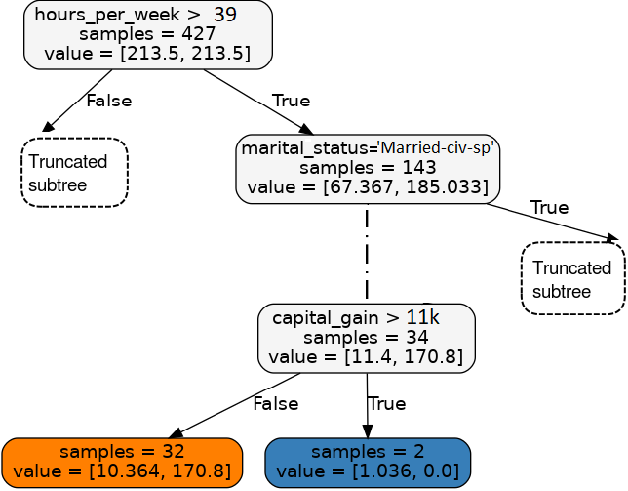
Concrete Example of Explanation (RQ3)
When the condition is {hours per week > 39 ∧ marital status != [‘Married-civ spouse’] ∧ hours-per-week <= 64 ∧ workclass = [‘Private’, ‘Self-emp-not-inc’, ‘Self-empinc’, ‘Federal-gov’] ∧ native country = [‘United-States’, ‘Cambodia’, ‘England’, ‘Puerto-Rico’, ‘Canada’, ‘Germany’] ∧ capital gain <= 11000},
we have a clear split between labels 1 (most harm) and 0 (less harm).
Notes:
An example of explanation rule we find to as a root cause of k-unfairness, and later use it for mitigation

Slide 15
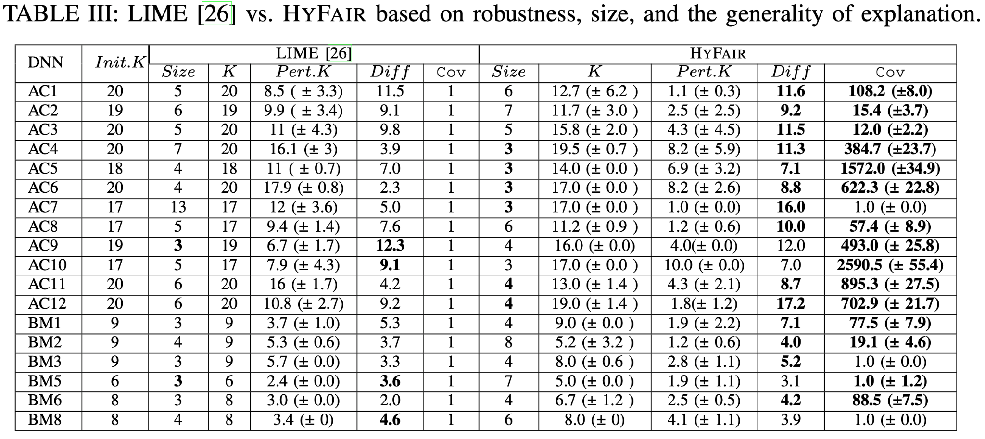
Explanations via HyFair vs. LIME (RQ3)

Slide 16
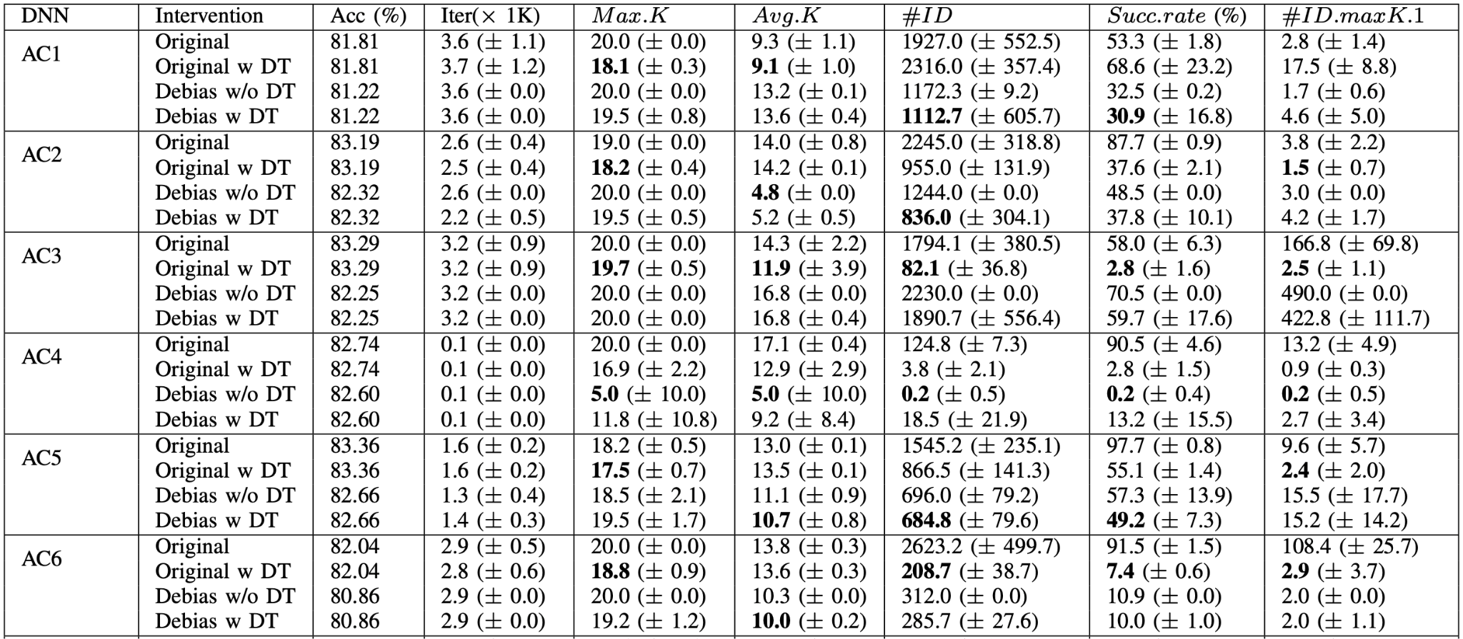
Debiasing k-discriminant via HyFair (RQ4)

Slide 17
Debiasing k-discriminant via HyFair (RQ4)
Answer RQ4:
Guardrailing DNNs via decision tree rules reduce k-discriminant as compared to data augmentation techniques.

Slide 18
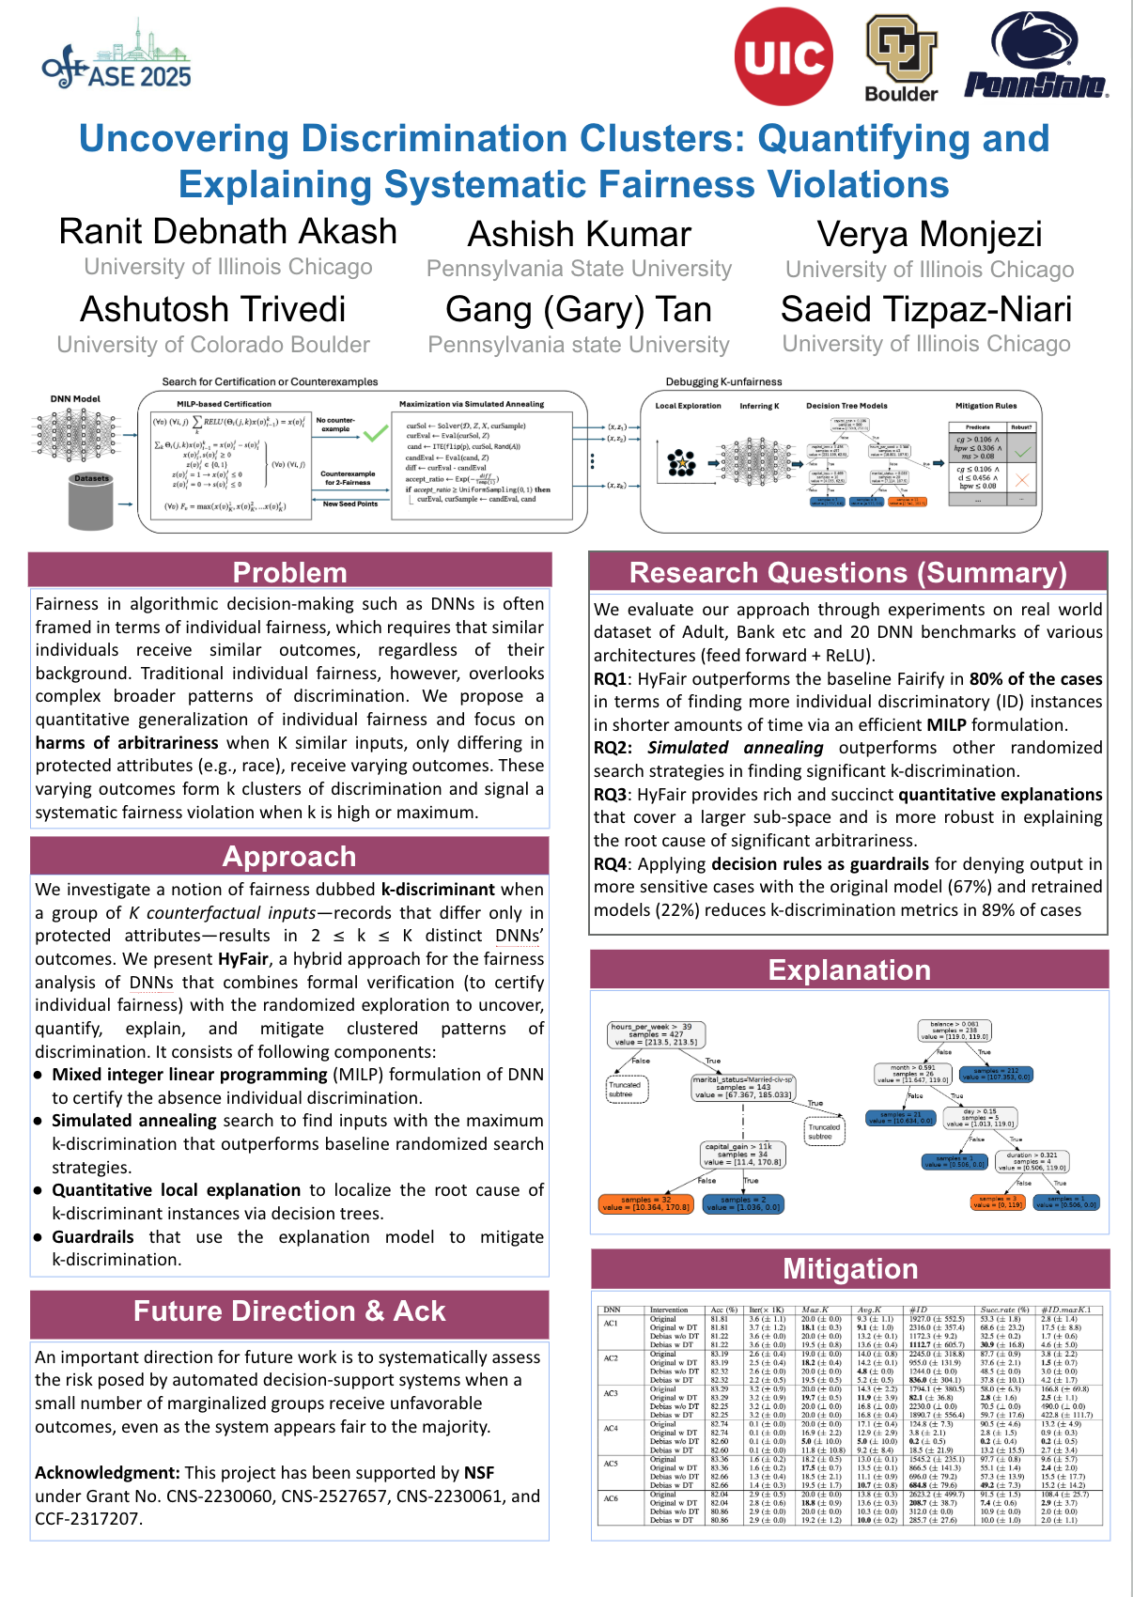
Invitation to see the poster!

